Slide 1


THE IMPORTANCE OF A CHARTER
Together we create possibilities for tomorrow
Elia Lima-Walton MD, PA
Principal Product Manager Healthcare Generative AI
Office of Chief Technology Officer
February 14, 2025

Slide 2
AGENDA
Charter Defined
Developing a Charter
Charter Entry Point in Product Life Cycle
Example Charters & Business Slides
Connecting to the Report Outline
Questions
Appendix
Elia Lima-Walton, MD, PA
February 24, 2025

Slide 3
CHARTER DISCUSSION
What is a charter?
Why is it important?
How do I put a charter together?
Things to consider:
What is the purpose
Why am I doing this
How does it connect my day to day with my personal development plan (PDP)
How does it connect with the overall business strategy
Elia L)ima-Walton, MD, PA
February 24, 2025

Slide 4
CHARTER DEFINED
Crucial business document
1. Describe a problem, need or objective. Explain in one or two sentences why a decision is needed. Be specific and include quantifiable measurements, if possible.
2. Describe the desired outcome/project goal(s).
In one or two sentences (at most) describe what will be different if the problem is solved, the need is fulfilled, or the goal is achieved. Do not provide any details of the solution.
3. Describe your proposed solution.
4. Explain how you'll overcome risks (include technical indicators, milestones, and dates).
5. State the business value and KPI’s.
6. Include team members and stakeholders.
Elia L)ima-Walton, MD, PA
February 24, 2025

Slide 5

TECHNOLOGY PHASING
Elia Lima-Walton, MD
February 24, 2025
Pre-discovery
Discovery
Proof-of-concept
Pilot
Production
Innovator entry point
Defining business problem. Data identification and requirements.
Identify previous learnings.
Translation to AI objective.
Charter intake
Data selection, processing.
Feature engineering.
Model selection, training, and evaluation.
Model meet expectation?
ROI across enterprise.
Addressing scalability.
Component integration.
Deploying automated processing pipeline.
Testing model end-to-end.
Confirming useability and acceptance.
Improvement identification.
Model and data review.
Model maintenance and iterative testing.
Mayo Clinic’s Product Life Cycle aligns technology processes across all functional disciplines. The product life cycle addresses a need for common processes, check-points, and stage gates. It ensures consistency, replicability, and clear understanding for teams using Mayo Clinic’s technology process.
The Mayo Clinic’s Product Life Cycle alignment with technology describes the activities in each phase to create a shared understanding for stakeholders and innovators. It identifies the people involved in each phase and their responsibility and expectations. The stage gates are outlined between the phases within the technology workflow so that teams know what must be completed before the next stage.
We expect completion of each applicable activity in each phase. Teams and innovators may tailor the activities or replace them with a description about why it should be exempt or changed. The spirit of the process and phases much be evident when adapted.
Aug
Oct
Nov
Dec
Jan
Feb
Apr
May
June
Q3 2025
Q4 2025
Q1 2026
Q2 2026

Slide 6

ALIGNING ACTIVITIES DS/GENAI WITH OUR PRODUCT & PLATFORM LIFE CYCLE
Elia Lima-Walton, MD, PA
Mayo Clinic
February 24, 2025
Opportunity
Ideation
Elaboration
Pre-launch
Introduction
Growth
Maturity
Decline
Sunset
Innovator, ML, Product Entry Point
Product Lifecycle
Data Science/GenAI Lifecycle
Pre-discovery
Discovery
*Data Engineering *Model Engineering
Proof-of-concept
*Productionization *BAU
Pilot
Production
Define business objective
Data selection, cleaning, prep
Quality metrics
Address scalability, automate data processing pipeline
Identify improvements, host team
Translate to ML/AI objective
Data harmonization, enrichment, labeling
Test end-to-end model pipeline
Model training & tuning
Model meets expectation?
Transform to microservices based on bus. features
Model & Data review
Develop model, coding
Data identification& collection
Charter, Intake
Model testing, assessment
Component integration
Model maintenance
Feature selection, engineering
Costs for operationalization, ROI
Confirm model useability & acceptance
Identify previous learnings of work
Model selection
Deploy model pipeline
Model testing
Data prep for evaluation
Product
Clinical SME
Decision Board
Software Engineer
Inject training & Data
Data Scientist
ML Engineer
Business Analyst
Data Engineer

Slide 7
Charter Outline
Background/Objective
Background: Lack of scalable, effective, and objective ways to practice and refine communication skills. The emotional toll of difficult conversations contributes to practitioner burnout and empathy erosion A lack of empathetic communication can amplify a patient's fear and grief, leading to a poorer emotional state, lower patient satisfaction, and decreased trust in their providers. Objective: Design and validate an AI/ML-based tool aimed at delivering timely, objective, and continuous feedback on conversational skills.
Goals | Technical Indictors
Explore skill development and training Validate objective feedback and assessment Improve well-being and professional development | Data input and processing (audio, video) Feedback delivery method, effectiveness Feedback Latency Reduction in faculty coaching time
Team Members Stakeholders Business Value & KPIs
Tanner Hochberg Elijah Don Alexander Roussas Ian Marcon Ethan Vanderpool | Healthcare Professionals & Medical Trainees Patients & Families Medical Educators & Training Institutions Healthcare Administrators & Institutions | Improved Patient-Healthcare provider relationship Improved Patient Satisfaction Mitigate Healthcare professional Burnout Improved Healthcare Professional/Trainee training and outcomes
Project Milestones
Project Definition and Alignment Needs & Model Research Model & Workflow Design Prototype or Pilot Development Implementation & Validation Prototype or Pilot Development 2 Implementation & Validation 2 Scale & Sustainability Planning

Slide 8

Hallucination Mitigation Strategies in Medical Question Answering (MQA)
Background/Objective
Background: As the number of patients to see at the point-of-care increases, so does the need to build AI systems that can facilitate diagnostic work-up and treatment. With the boom of LLMs there are systems which appear promising, providing confident and almost convincing answers, yet when compared against the source truth they fall short. In this capstone we will demonstrate the potential for LLMs to be effective tools in the clinical decision-making process, while also emphasizing the importance of careful evaluation and exploration of hallucination mitigation strategies. Objective: 1. Develop a framework to explore the role of medical LLMs and their safe deployment at the point-of-care. 2. Identify hallucination mitigation strategies to ensure answers retrieved by medical question answering system mitigates harm or false information.
Goals | Technical Indictors
1. Implement workflow for automated hallucination detection for medical queries written in natural language. 2. Retrieve medical information that is factual, actual, and relevant with minimal to no hallucination. 3.**Stretch goal explore bias detection on answers being retrieved by LLM. | 1.Ingestion of dataset 2.Embed and store all medical dataset into vector database 3. Embed the user’s query and retrieve semantically similar documents from the stored vector knowledge base. 4.Provide the retrieved documents to LLM as contextual input 5. LLM generates a response, prioritizing factuality, relevance, and accuracy in the answer derived. 6.Develop and implement framework for mitigation of hallucination detection. 7.Deliver the generated, precise response back to the user 8. Experimental baseline findings, improvements, next steps, etc..
Team Members & Stakeholders
Elia Lima-Walton
Business Value & KPIs
1.Improved clinician search experience 2.Decrease time for users to find what they are searching for. 3.Improved point-of-care search
Project Milestones
Study development (TBA) Carryout study (TBA) Evaluate study results (TBA) Disseminate results (TBA)
Elia L)ima-Walton, MD, PA
February 24, 2025

Slide 9

ANY QUESTIONS…
Elia L)ima-Walton, MD, PA
February 14, 2025

Slide 10
Extracting Symptoms, Treatment, Diagnostic Procedure, and Drug Relationships from Medical Content at Scale
Background/Objective
Background: There is a need for Clinical Key to continue to retrieve content to meet point-of-care needs. CK Search relies in part on special tagging of Clinical Overviews in the form of “triple tags” (associative relationships in the model of subject-predicate-object). CK Global is interested in being able to use “triple tags” to help surface content embedded in core synoptic content for NOAM and regional markets. In order to help expedite tagging of content in triple fashion for search we need to improve the auto-tagging process. The candidate triples that will be generated by this process will potentially benefit information retrieval for NOAM, CK India, CK Germany, CK Brazil, CK France and potentially other CK products—EMMeT ontology, H-Graph, thereby enhancing utility for other use cases. Objective: 1. Algorithmically identify ontological relationships embedded within core and localized synoptic content: a.)Triple identification: Matching content to be tagged with known/existing triples b.)Triple extraction: Extracting triples or triple candidates from content to be tagged, for triples that are novel or never previously encountered/recorded 2. Perform QA of triple tags to improve Search.
Goals | Technical Indictors
1. Implement workflow automatic tagging of triples to reduce time and money spent on traditional curation methods. 2. Work with NOAM core synoptic content, THB, KLF, EMC, PT-BR CO, localized Clinical Overviews, Clinical Snapshots, and other content types to assess feasibility for proof of concept. 3. Streamline tagging for more efficient process decreasing SME time spent and cost. 4. Reduce error/improve standardization in triple tagging: Improve accuracy of tagging to 50%; reduce time spent by SME to validate by 50%; Improve ontological tagging across ClinicalKey. | 1. Acquire NOAM and localized content. 2. Determine model baseline performance for each document type 3. Adaptation of automated tagging guidelines to fit specific use case. 4. Workflow Implementation 5. QA output 6. Review learnings
Team Members & Stakeholders
Team Members: Elia Lima-Walton Silke Niehusmann | Ankur Walia Will Dowling Maulik Kamdar | Stakeholders: A,b,c
Business Value & KPIs
•Identify and expand ontological triples •Improved clinician search experience improving accuracy of diagnosis •Decrease time for users to find what they are searching for. •Ontology expansion, POC search
Project Milestones
•Acquire data to be tested (x) •Determine model baseline performance for each document type (x) •Review output, customize guidelines, increase performance (x)
Elia L)ima-Walton, MD, PA
February 24, 2025

Slide 11

AI Models Combined with our Own Data Produce State of the Art Predictions, Empower Clinicians and Students to Discover Content
Background/Objective
Background: ClinicalKey (Physician) suffers from low usage competitiveness compared to UpToDate and ScienceDirect, directly contributing to a shortfall in revenues – estimated UTD advantage is 12x content views and 2.5x revenues; estimated SD advantage is 2–3x usage of health sciences journals by clinicians. Much of the traffic for these products comes through Google searches, which CK cannot presently compete with as its content is not indexed. Leveraging Google search traffic and advantages of SD SEO for less common diseases to raise awareness of and drive users to CK, both in B2B and B2C markets, would lead to significant increased usage and thereby increased retention of the B2B customer base (lower cost-per-use) and increased traffic/conversions via the B2C web store. Create ClinicalKey Topic Pages that are indexable and searchable on Google (similar to SD Topic Pages). We propose an incremental three-phase project, initially testing the feasibility and impact of CK Topic Pages, followed by expansions dependent on the outcomes of each phase: Phase 1: Pilot study to determine impact of auto-generated CK Topic Pages with full spectrum of CK content, hosted on ScienceDirect (BAU expensed) Phase 2: Refinement and expansion to maximize impact of CK Topic Pages (using incremental CK/SD resources where required) Phase 3: Further support B2C efforts via e-commerce and packaging/pricing improvements; enabling updates to content on topic pages The hypothesis is that surfacing CK Topic Pages through Google and via the SD platform will immediately increase awareness and usage of CK which will directly improve B2B renewals/uplift and generate new B2C sales.
Goals | Technical Indictors
1. Successful generation of up to 20,000 accurate Topic Pages from CK content, hosted on SD and demonstrating SEO capability 2. Refine and expand CK Topic Pages 3. Update CK Topic Pages and improve eCommerce setup, packaging/pricing | Assessment of relevance of CK Topic Pages by SME Functioning links from CK Topic Pages, hosted on SD, to CK Physician content and eCommerce store Establishing needed backlinking to CK Topic Pages for SEO Analytics in place for tracking traffic, click-through rates to CK and eCommerce store, CK usage increase, conversion into B2C trials & paid subscriptions Enabling updates to CK Topic Pages
Business Value & KPIs
Increase awareness for CK Physician Increase usage of CK Physician improve B2B renewals/uplift generate new B2C sales
Project Milestones
Goal 1:generation of CK Topic Pages and handover to SD team: November 2020 – March 31, 2021 hosting on SD and SEO: Q2/2021 Goal 2: Q2/2021 Goal 3: Q3-Q4/2021
Team Members
Elia Lima-Walton
Stakeholders
A,b,c
Elia L)ima-Walton, MD, PA
October 14, 2024

Slide 12
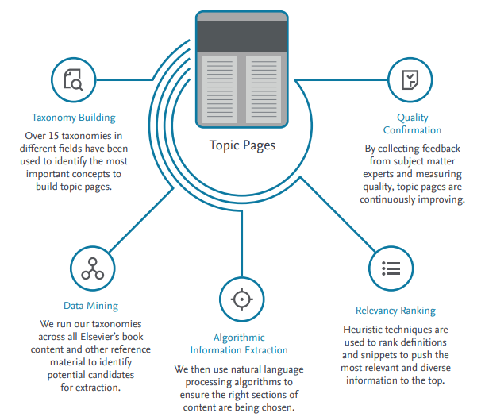
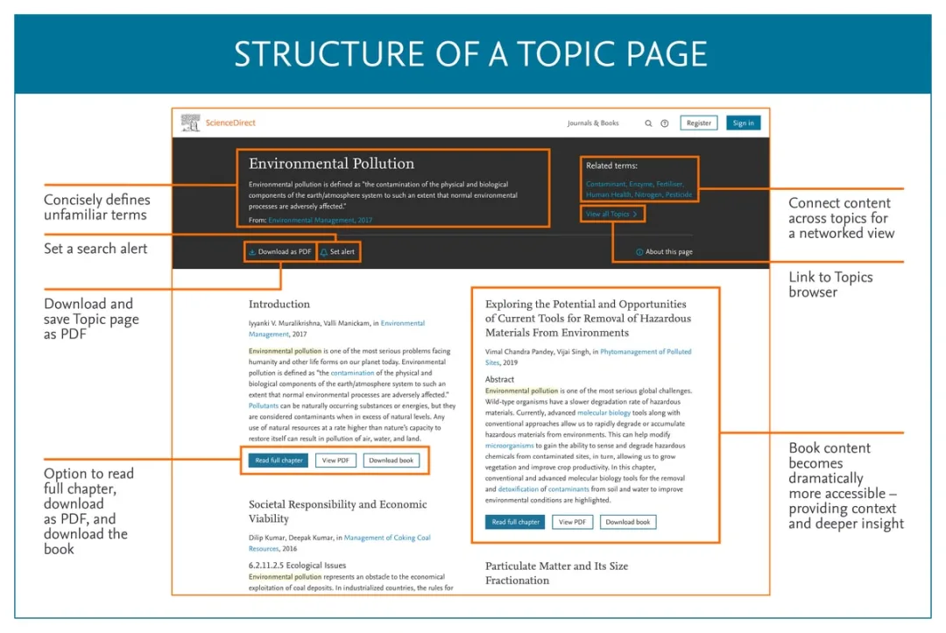
AI MODELS COMBINED WITH OUR OWN DATA PRODUCE STATE OF THE ART PREDICTIONS, EMPOWER CLINICIANS AND STUDENTS TO DISCOVER CONTENT
Elia L)ima-Walton, MD, PA
February 24, 2025
Notes:
BERT (Bidirectional Encoder Representations from Transformers) is a method of pretraining language representations that was used to create models.
We can use these models to extract high quality language features from text data or can fine-tune these models on a specific task (classification, entity recognition, question answering, etc.) with our own data to produce state of the art predictions.
ClinicalKey and ScienceDirect Topic Pages are indexable and searchable on Google
Provide definitions and related terms for each concept as well as snippets of high-quality, relevant, peer-reviewed content
Enrich content with hyperlinks to other topics of interest: images, calculators, articles, book content
Offer hundreds of thousands of comprehensive and topical web pages
Improve the physician and student search experience
Free to access through ScienceDirect

